Slide 1
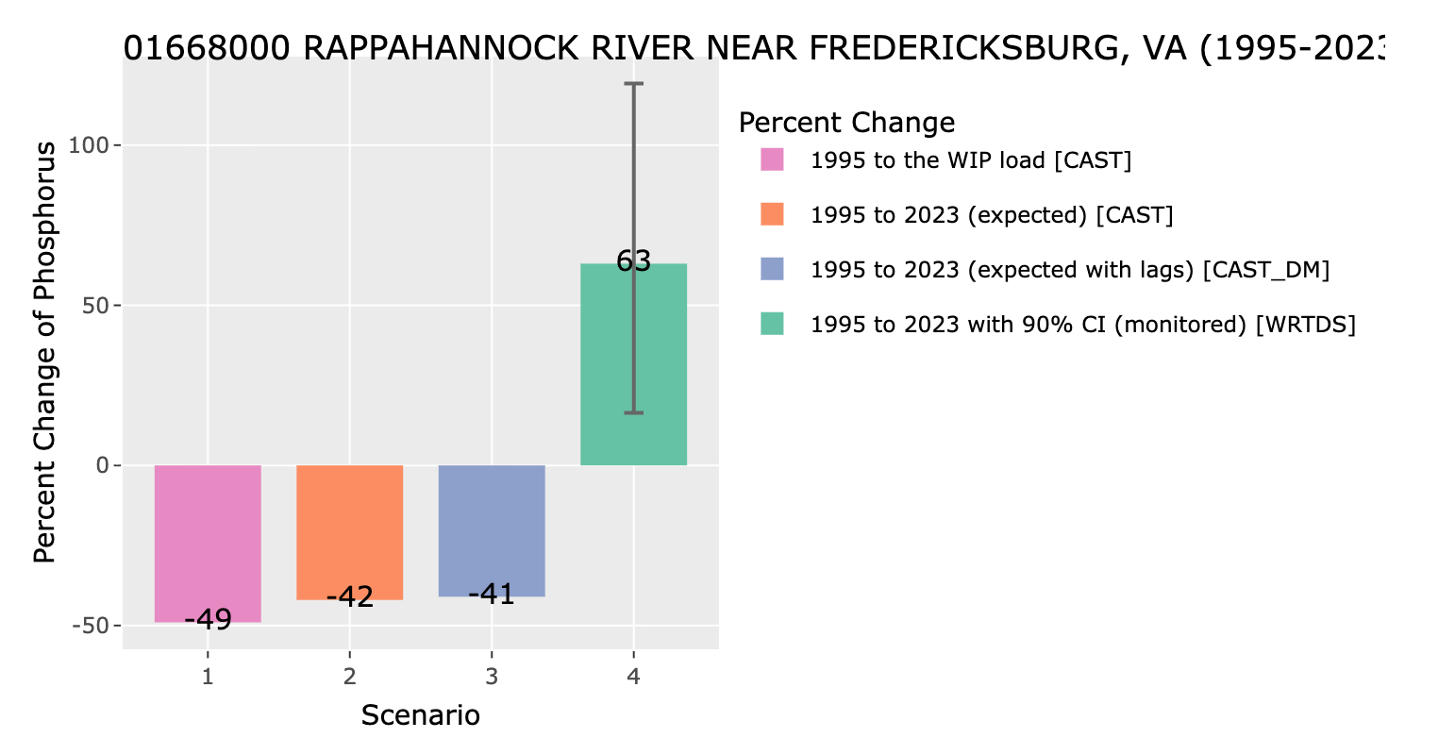
The Work Left to Do
Model estimates
What we observe
Nitrogen reductions still needed (estimated by CBP):
In some areas, we have more work to do than we think
32 million pounds/yr
Annual rate of nonpoint source N reductions since TMDL (2009)
Model estimates
0.3 million pounds/yr
Goal
Monitored

Slide 2
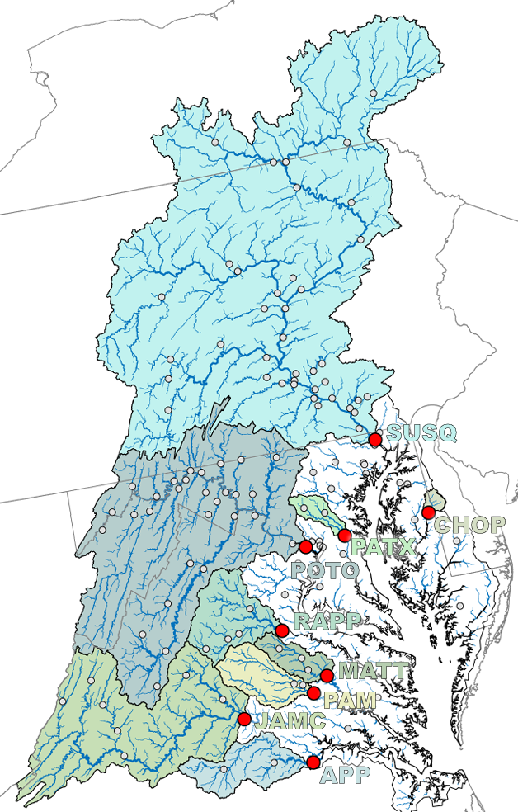
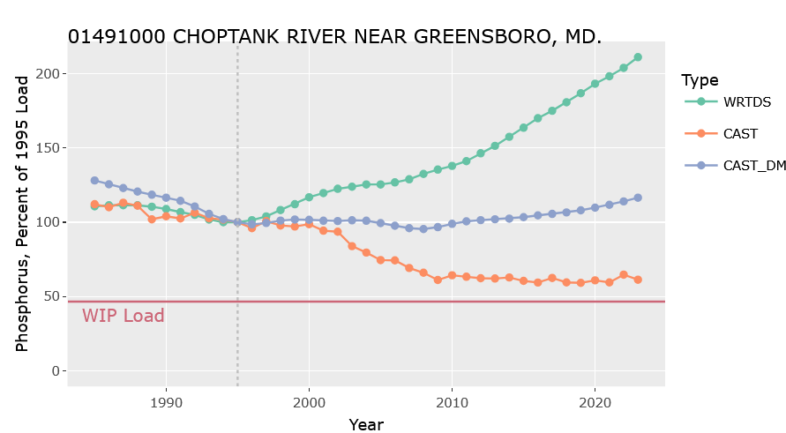
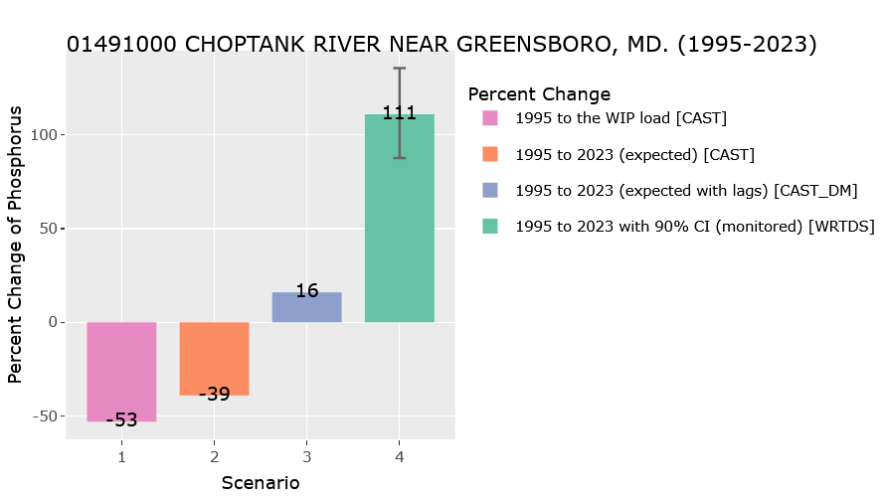
Outcomes we observe
 | Nitrogen |  |  | Phosphorus
River Input Monitoring Stations | CAST change in load | Change monitor load | Does CAST fall outside 90% CI? | CAST change in load | Change monitor load | Does CAST fall outside 90% CI?
Susquehanna | -3% | -4% | No | 21% | 29% | No
Potomac | -11% | -13% | No | -11% | 10% | No
James River | 11% | 3% | No | -15% | 3% | No
Rappahannock | -16% | 13% | Yes | -46% | 57% | Yes
Appomattox | 11% | 22% | Yes | 5% | 22% | Yes
Pamunkey | -9% | 14% | Yes | -23% | 23% | Yes
Mattaponi | 6% | 16% | Yes | 19% | 5% | Yes
Patuxent | -33% | -32% | No | -29% | -21% | No
Choptank | -1% | 20% | Yes | 29% | 95% | Yes
Example: Phosphorus in the Choptank
Notes:
Response gap. Estimates of nutrient load reductions relative to monitored loads by major bay tributaries (1995-2020), calculated by comparing the dynamic CAST model estimated TN and TP loads against flow-normalized observed load* (WRTDS- weighted regression on time discharge and season) with 90% confidence interval (CI) calculated. Bold values present conditions where CAST estimates fall outside of the WRTDS-CI estimate. (Source: Monitored and Expected Total Reduction Indicator for the Chesapeake-METRIC, 2024).
Example of the phosphorus response gap for the Choptank River MD and Potomac River, MD. WIP -Watershed Implementation Plan, CI - Confidence Interval. (Source: Monitored and Expected Total Reduction Indicator for the Chesapeake-METRIC, 2024).

Slide 3

Other
Exports
Mass Balance: What goes "in" must come "out" or get "stored"
Farm Nutrient Mass Balance
Mass Balance for Urban BMP
Nutrient Imports
Nutrient Exports
Feed
Nutrient Imports
Nutrient Exports
FARM
Milk
Nutrients in runoff
Urban BMP:
Bioretention
Fertilizer
To water
Crops
Animal
Animal
Water &
Atmosphere (N)
Other
Imports
Other
Exports
Storage
Surplus
Export to Water & Atmosphere (N)
Storage
(soils, GW, biota)

Slide 4
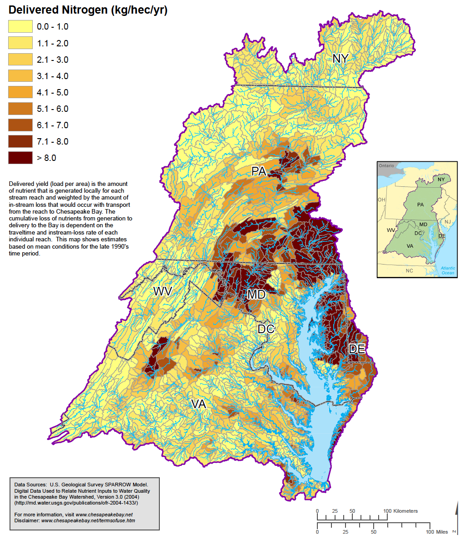
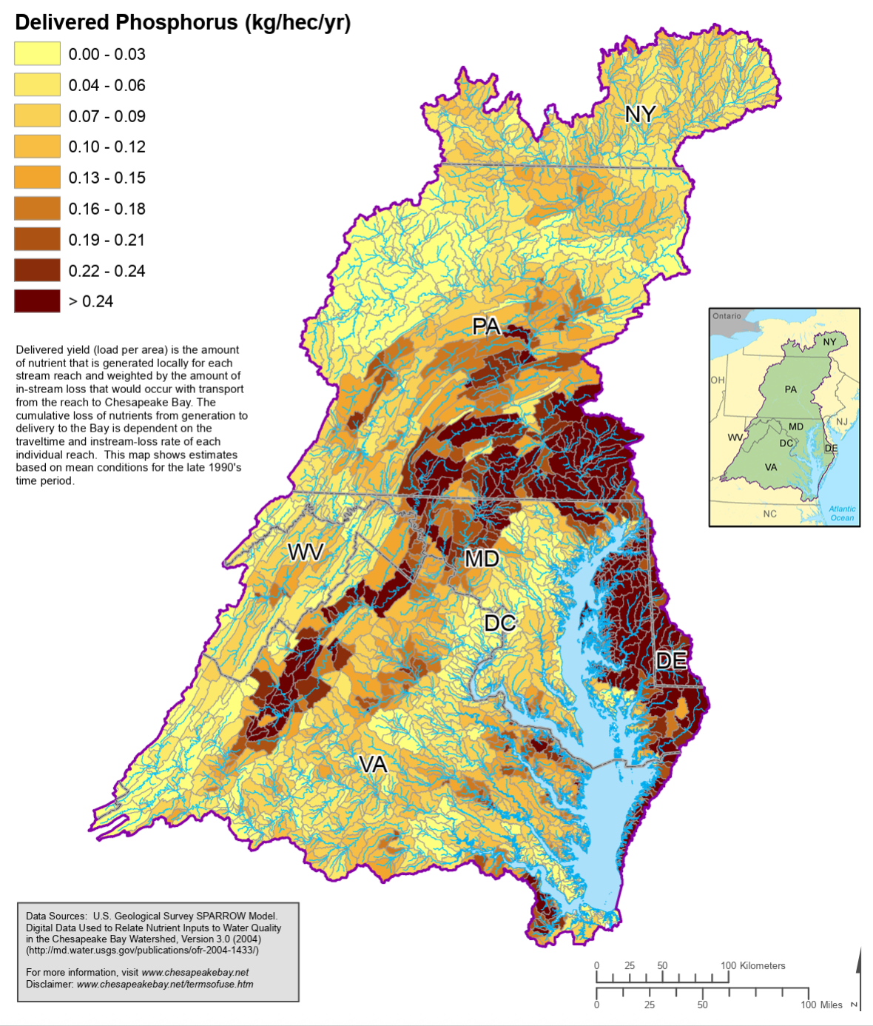
What areas are contributing the most nutrients loads?
Delivered Phosphorus (kg/ha/yr)
Delivered Nitrogen (kg/ha/yr)
0.00 – 0.03
0.04 – 0.06
0.07 – 0.09
0.10 – 0.12
0.13 – 0.15
0.16 – 0.18
0.19 – 0.21
0.22 – 0.24
> 0.24
0.0 – 1.0
1.1 – 2.0
2.1 – 3.0
3.1 – 4.0
4.1 – 5.0
5.1 – 6.0
6.1 – 7.0
7.1 – 8.0
> 8.0

Slide 5
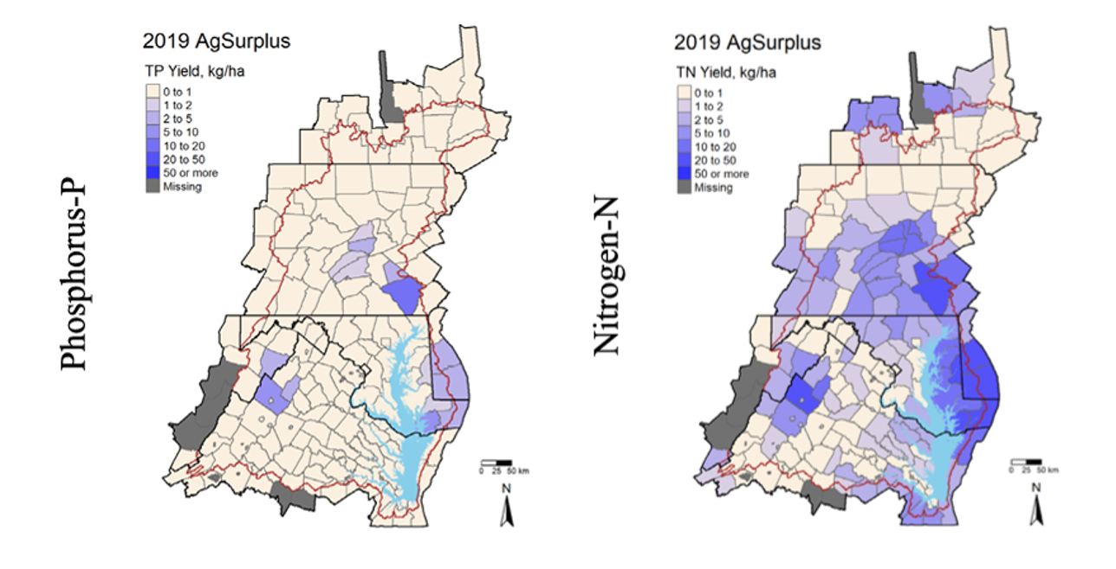
Mass Balance: Areas with Surplus Phosphorus and Nitrogen
2019 Agricultural TP
Surplus (kg/ha)
2019 Agricultural TN
Surplus (kg/ha)
0 – 1
1 – 2
2 – 5
5 – 10
10 – 20
10 – 50
>50
Missing
0 – 1
1 – 2
2 – 5
5 – 10
10 – 20
10 – 50
>50
Missing

Slide 6
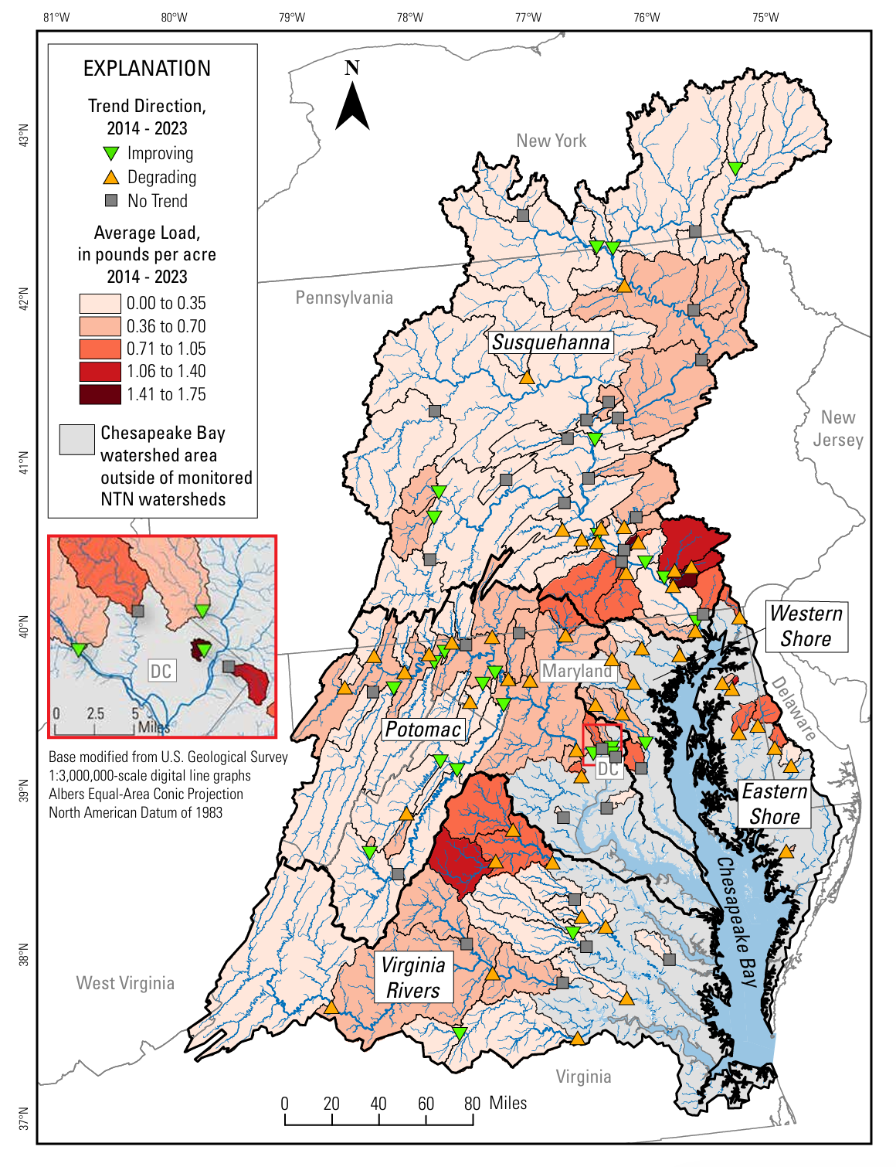
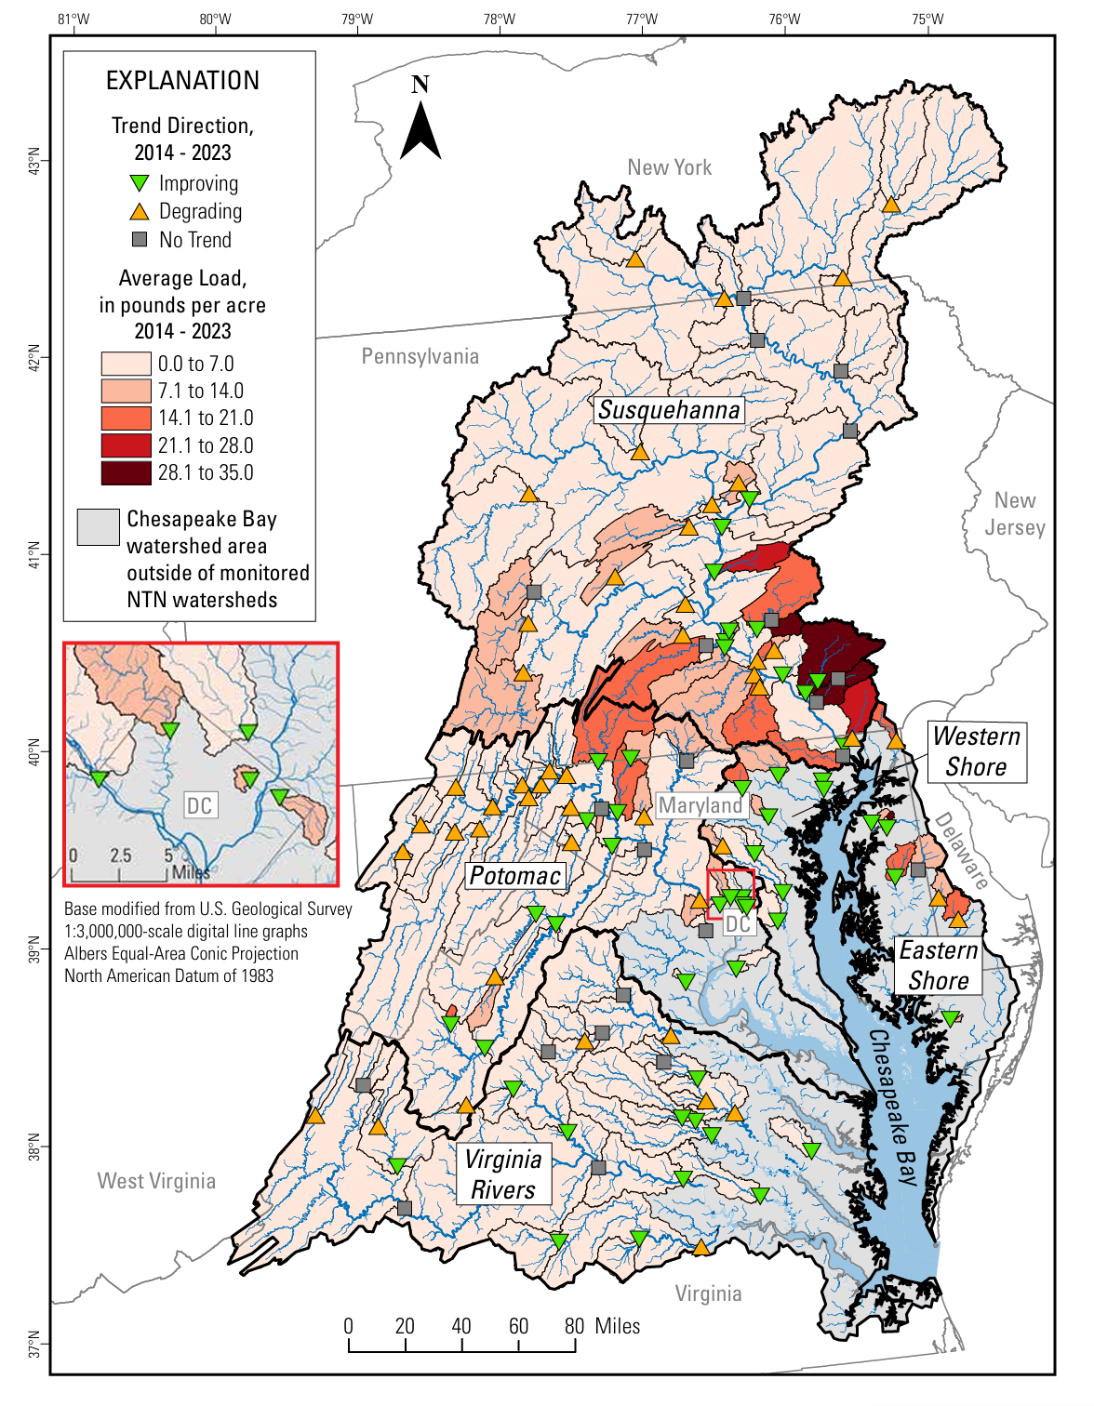
Phosphorous
Nitrogen
Notes:
High TP and TN losses are associated with large nutrient surpluses
Decreasing water quality trends likewise associated with surpluses

Slide 7
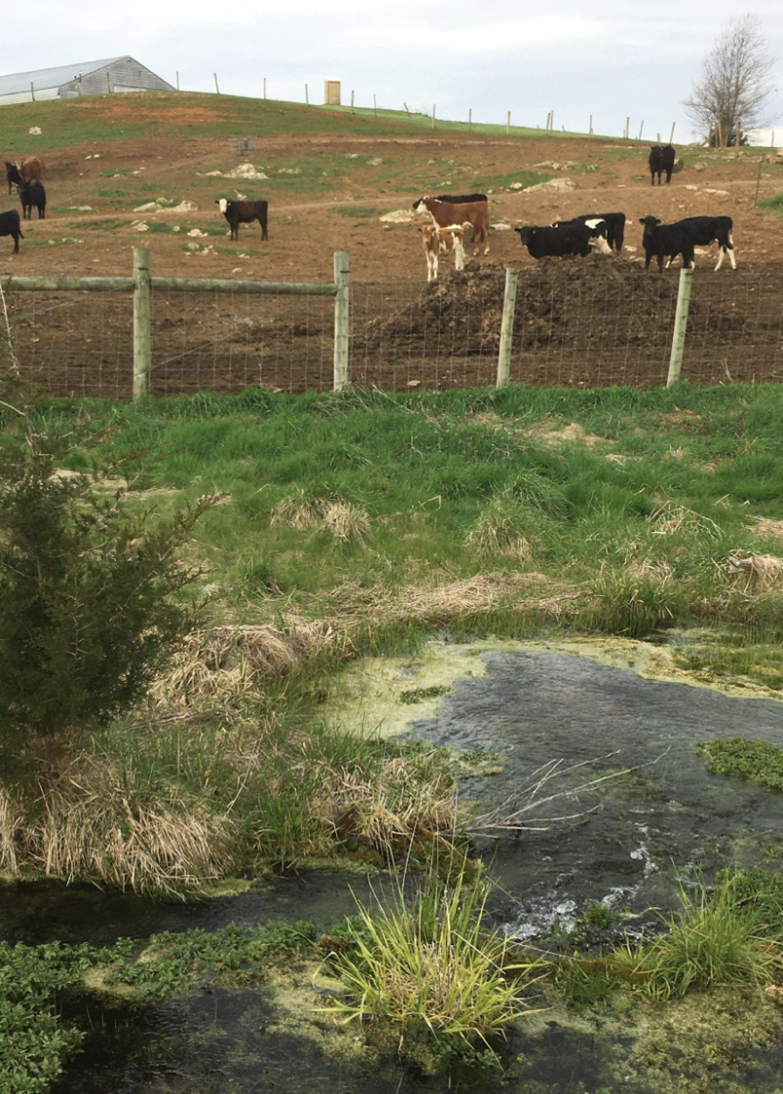
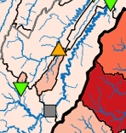
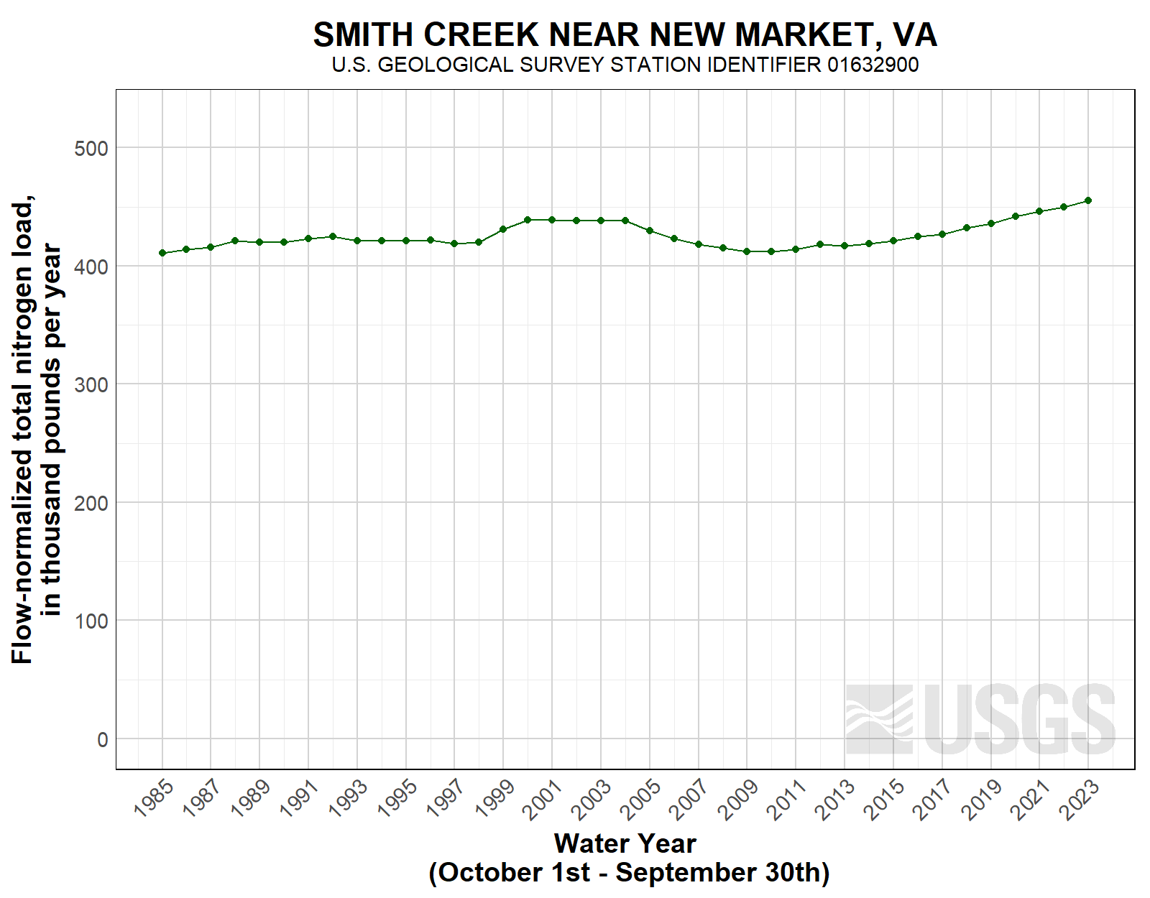
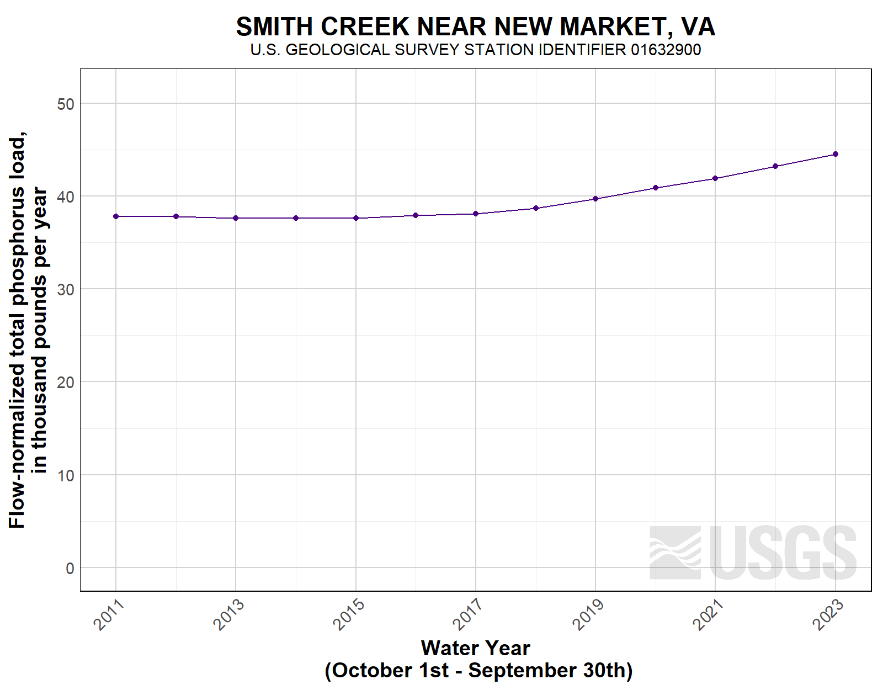
CBP showcase watershed: Smith Creek, VA
Intensive monitoring and BMP implementation
Dominated by livestock agriculture
Significant, increasing nutrient mass imbalance
Legacy nutrients in soils and groundwater contribute to lag times in water quality response
Nitrogen
Phosphorus
Notes:
Smith Creek illustrates the “response gap”, where management actions do not yield expected water quality improvements.
Highlights the need for targeted interventions, mass balance management, and outcome-based incentives.

Slide 8


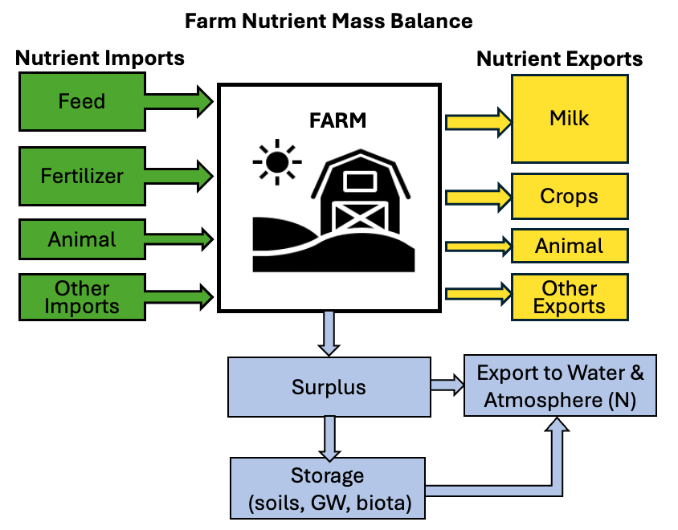


CAST, BMPs, and Mass Balance
CAST Accounting
Watershed planning and Implementation Programs
What is counted
What isn't
$ offer
Adoption
BMP
Cost share
(% of BMP cost)
Predictions of Pollutant reduction outcomes
Model
State reporting

Slide 9
A way forward….. Directing Investments
Farm
Watershed to
# of Farms
Large Nutrient Surplus
-
0
+
Nutrient Mass Balance (kg/ha)

Slide 10
A way forward….. Measuring Progress
Moves program closer to measuring outcomes, not effort (practices)
Can be used at different scales to identify opportunities for nutrient reduction
Comprehensive picture of nutrient flows
Direct benefits to management entity (improved nutrient use efficiency)
Farm Nutrient Mass Balance
Nutrient Imports
Nutrient Exports
Feed
Milk
FARM
Fertilizer
Crops
Animal
Animal
Other
Imports
Other
Exports
Surplus
Export to Water & Atmosphere (N)
Storage
(soils, GW, biota)

Slide 11
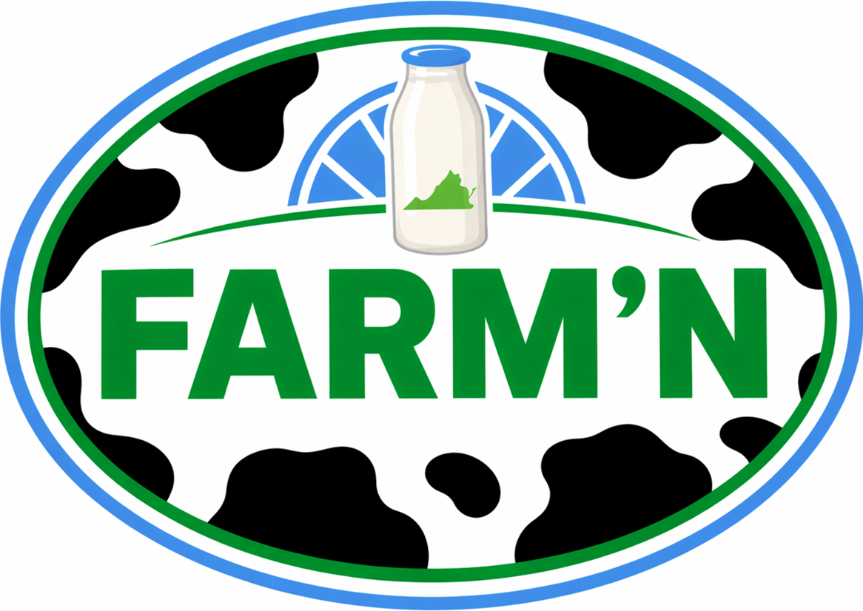

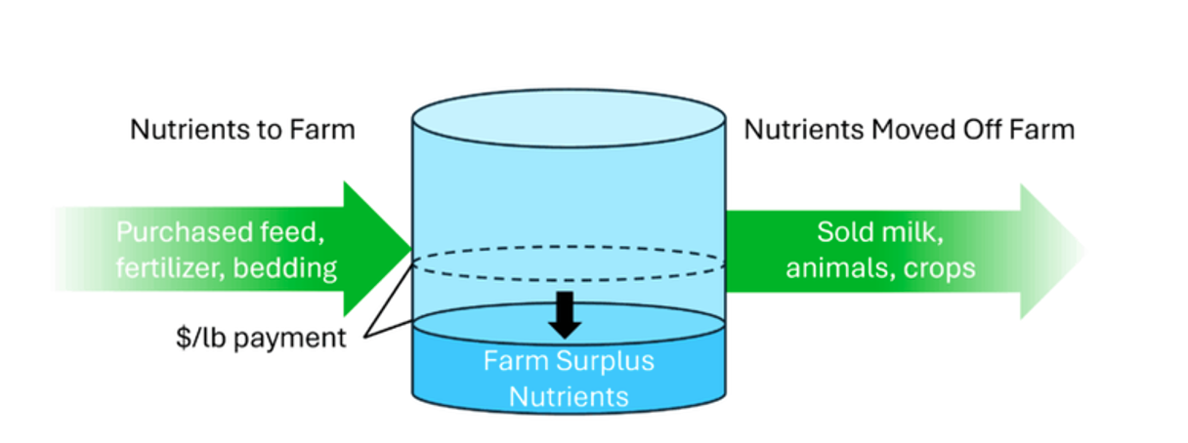
A way forward….. Improving Incentives
Pays Virginia dairies for the amount of N surplus reduced
Aligns financial incentive with desired environmental outcome
Encouraging flexibility and innovation
Creates verifiable and auditable metric using routine farm data

